Slide 1

AIRBNB
Tableau Dashboard
Cody Furr, Grant Howard, Corey Howard, Derek Pedersen

Slide 2
Visualization
Data
Revenue
Price
Listings
Rental Type
Apartments/Entire House
Shared Room
Private Room
Neighborhood Group
Manhattan
Brooklyn
Bronx
Queens
Staten Island
Neighborhood
Worksheets
Listing by Borough
Room Type by Borough
Price Per Bedroom
Borough Listing By Year
Revenue by Year
Profit by Host
Notes:
Questions:
Is there a significant difference in listing distribution among the boroughs?
What is the most common room type (entire home/apartment, private room, shared room) in each borough?
Which borough offers the most cost-effective price per bedroom?
Which borough experienced the fastest growth in Airbnb listings over time?
How has Airbnb revenue trended year-over-year in NYC?
Are there hosts or boroughs significantly outperforming others in terms of profitability?

Slide 3
Questions
Is there a significant difference in listing distribution among the boroughs?
What is the most common room type (entire home/apartment, private room, shared room) in each borough?
Which borough offers the most cost-effective price per bedroom?
Which borough experienced the fastest growth in Airbnb listings over time?
How has Airbnb revenue trended year-over-year in NYC?
Are there hosts or boroughs significantly outperforming others in terms of profitability?

Slide 4
Challenges
Make sure to use significant data points
Getting rid of missing data
Outliers can skew the visualization
Complex visualization can confuse the audience

Slide 5
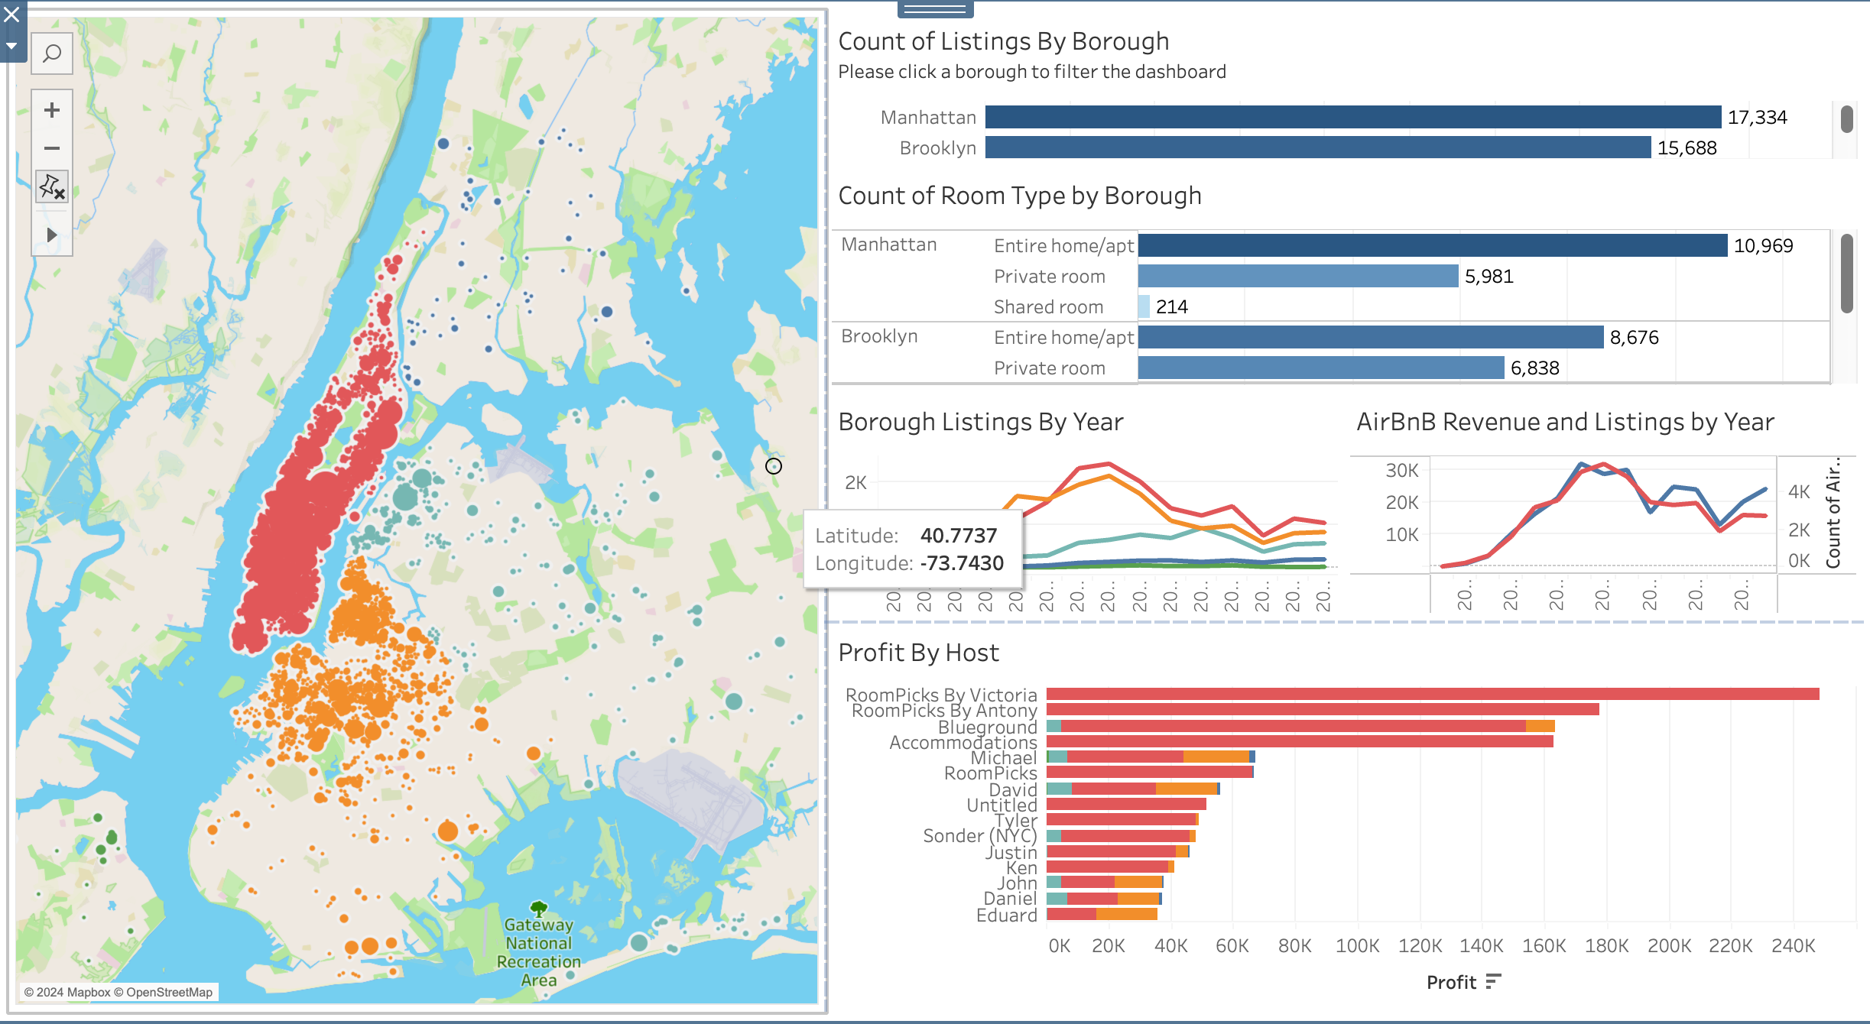
Results
Notes:
Listings By Borough: From the data you can see that Manhattan leads the Airbnb market with 17,334 listings while Brooklyn is close behind with 15688
Room Type: Manhattan has the most entire home/apartments with 10,969 while Brooklyn only had 8,676 apartments. Brooklyn has the highest private room type showing affordable/ shared space in residential areas

Slide 6
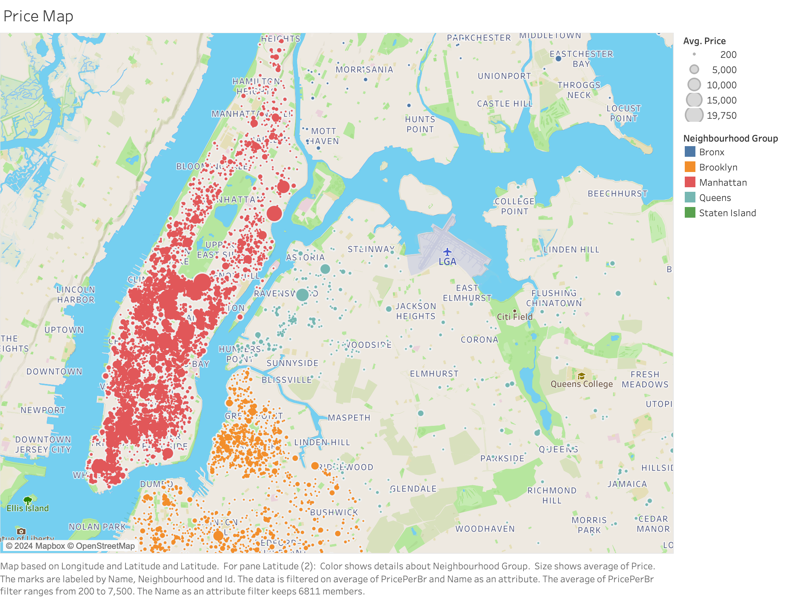
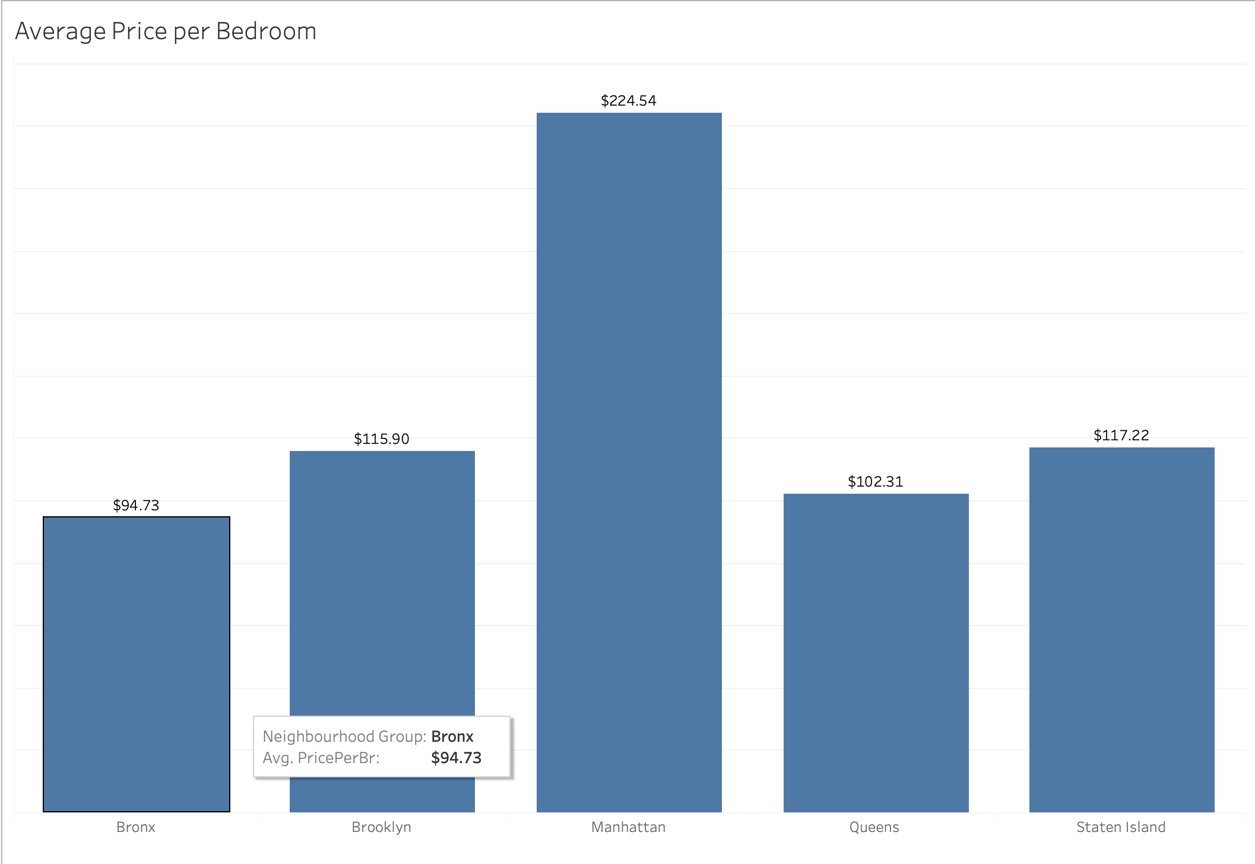
Affordability and Geographic Location
Notes:
Affordability: Bronx is the most affordable whereas Manhattan is the most expensive due to the tourist attractions like Times Square and Central Park.
Geographic Location: Convenient access to public transportation enhances the appeal of rentals. Manhattan and Brooklyn see higher prices due to their proximity to tourist attractions and business centers. Meanwhile, Queens offers a balanced option with moderate prices and easy access to key locations like JFK Airport and Flushing Meadows.

Slide 7
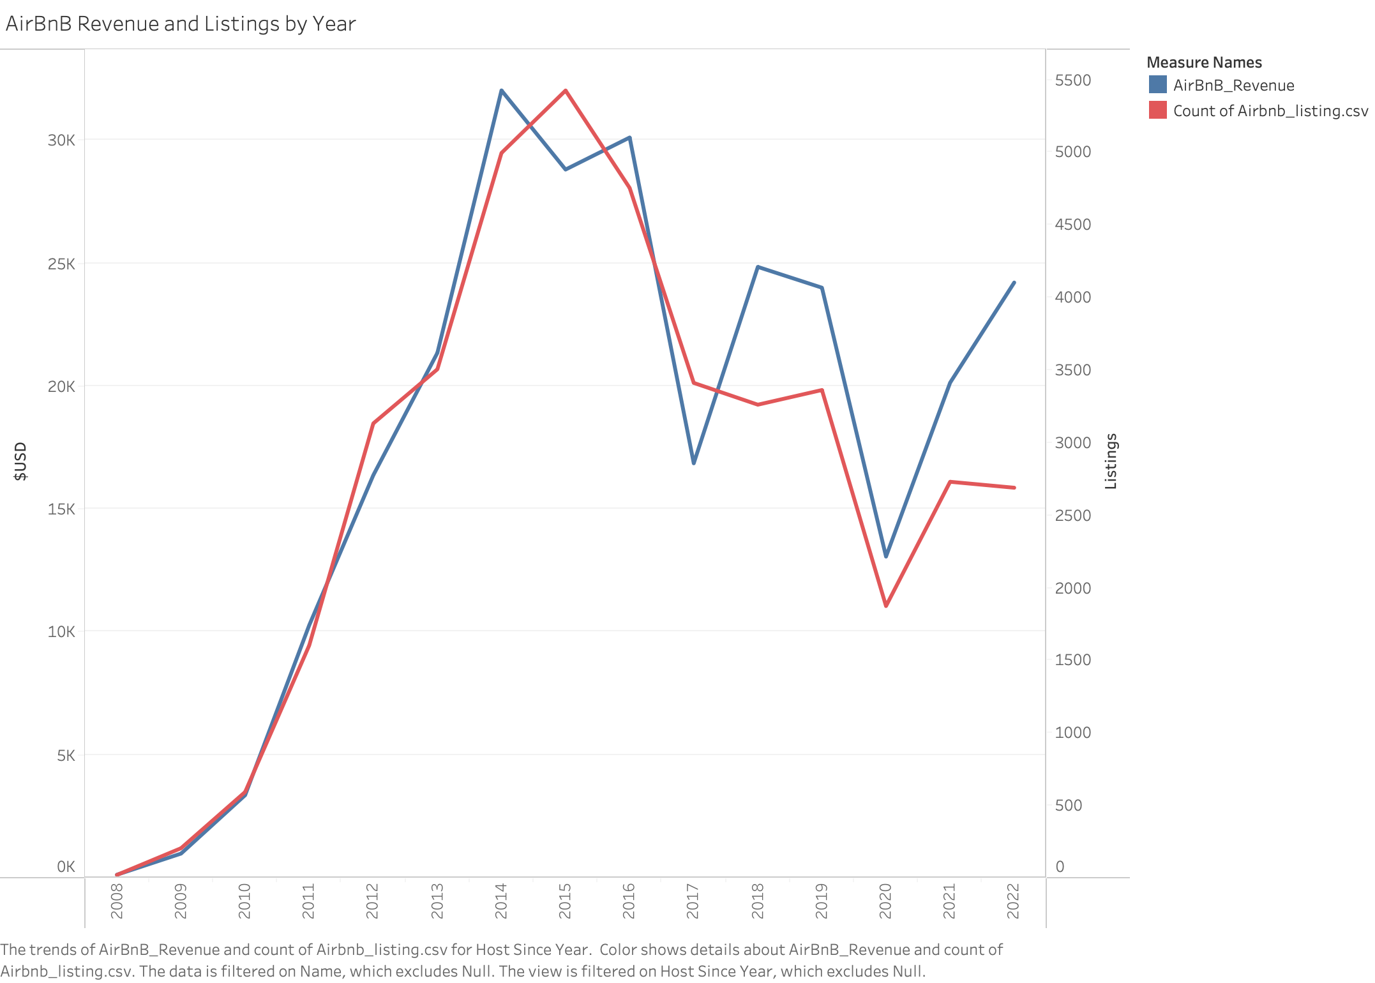
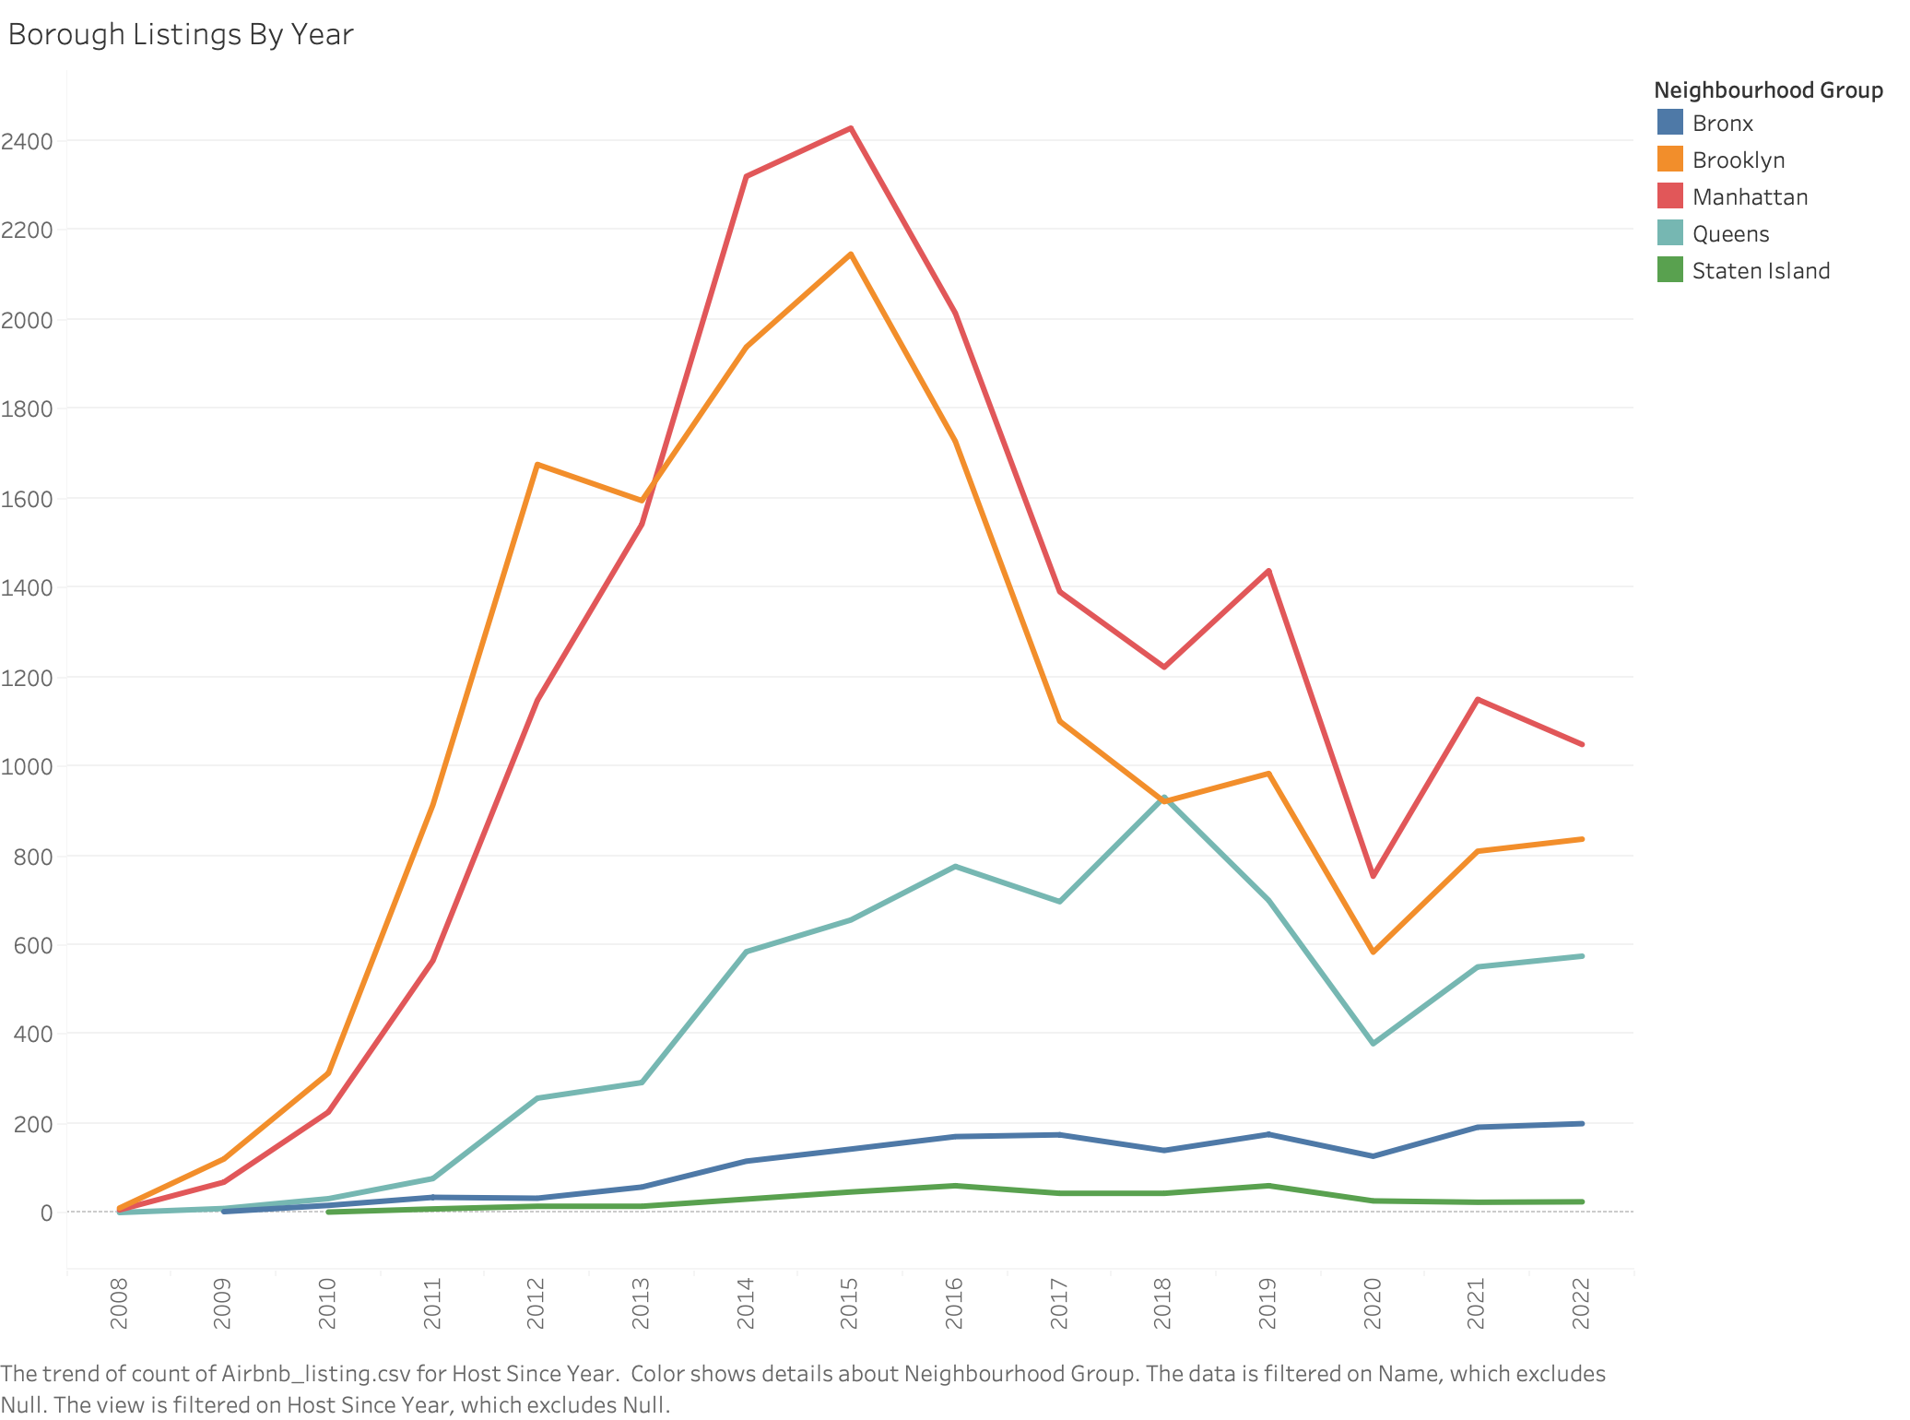
Listing and Revenue Over Time
Manhattan: 2429 Listings
Brooklyn: 2147 Listings
Queens: 931 Listings
Notes:
Manhattan and Brooklyn have grown in popularity with a massive increase around 2011. Queen is steadily getting popularity throughout the years. But Staten Island and Bronx have not increased that much.
Airbnb saw its highest increase in new hosts in 2015, with over 4,000 listings added, showcasing the platform’s growing appeal and financial success. In recent years, the number of listings has leveled off, suggesting that the NYC Airbnb market has matured and reached a stable, competitive state.
Airbnb’s revenue from NYC rentals has grown steadily, peaking around 2015–2016. By 2022, annual revenue surpassed $25 million, showcasing the platform’s ability to generate significant profits in a single metropolitan area.
The year-to-year revenue trends suggest that NYC remains one of Airbnb’s most lucrative markets.

Slide 8
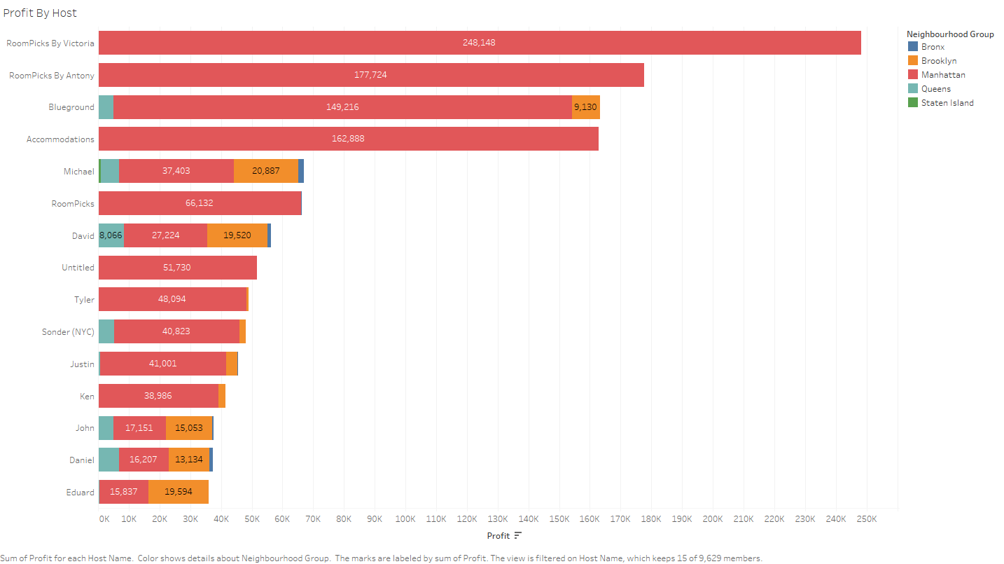
Top Profitable Hosts
01
02
03
RoomPicks By Victoria leads with an impressive annual earning of $255,823, setting the benchmark for profitability.
RoomPicks By Antony follows closely, generating $167,926 annually, benefiting rom strategic property management.
Blueground ranks third, earning $69,110, showcasing effective use of entire-home rental strategies.

Slide 9


Traits of Successful Hosts and Airbnb's Earnings from Fees
Key Characteristics of High-Performing Airbnb Hosts
Successful hosts often manage multiple properties to maximize earnings.
Properties located in high-demand areas like Manhattan and Brooklyn attract more guests.
Entire-home rentals typically command higher nightly rates than shared accommodations.
Airbnb's Annual Earnings from Service Fees in NYC
Airbnb charges a 3% service fee on every rental transaction, significantly contributing to its revenue.
In New York City, Airbnb's annual earnings from these service fees exceed $750,000, highlighting its profitable business model.
The service fee structure allows Airbnb to maintain a sustainable income while providing hosts with a platform to reach potential guests.

Slide 10
Recommendations for Current Hosts
Enhance Rental Amenities
Improving amenities such as Wi-Fi, parking, and air conditioning can significantly increase property appeal and allow for higher pricing.
Prioritize Positive Reviews
Encouraging guests to leave positive reviews enhances visibility and trust, directly impacting occupancy rates and profitability.
Leverage Strategic Location
Market the property based on its proximity to attractions and affordable rates, especially in boroughs like Brooklyn and Queens to attract budget-conscious travelers.

Slide 11
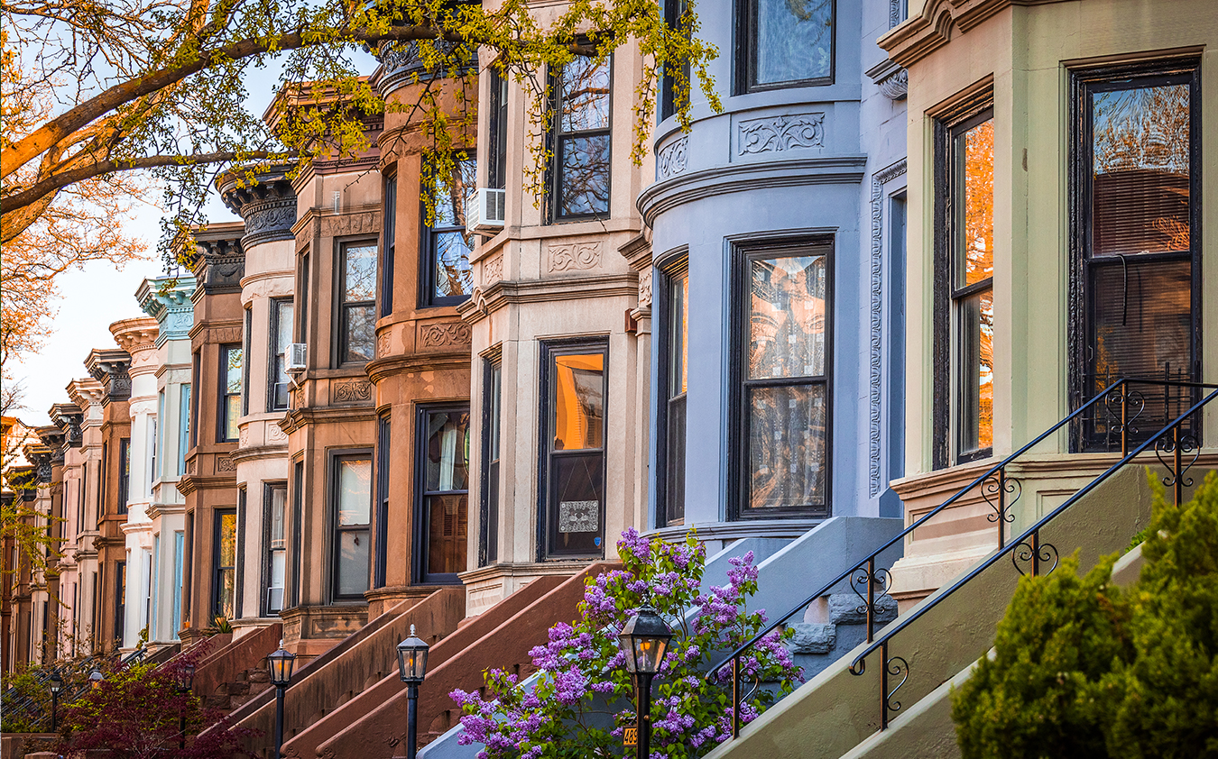
Advice for Potential Hosts
Key Strategies for Success
A prospective host, such as Julie in Queens, could charge between $125–$150 per night for a well-maintained 2-bedroom house.
By renovating her basement to add a third bedroom and a second bathroom, Julie could increase her rental price to approximately $175–$200 per night.
A $15,000 renovation can be recouped within 8–12 months, depending on market demand and occupancy rates, making it a worthwhile investment.
Understanding the competitive landscape is crucial; Julie's main competition includes neighborhoods like Astoria and Flushing, where similar properties average around $140–$160 per night.
Highlighting proximity to local attractions and amenities can attract budget-conscious travelers, enhancing occupancy rates.

Slide 12
Airbnb's profitability in NYC is heavily influenced by specific borough trends and host strategies.
The analysis shows that Manhattan & Brooklyn are the most lucrative boroughs for hosts, due to high demand & premium rental rates. However, neighborhoods like Queens & The Bronx offer unique opportunities for affordability, attracting budget-conscious travelers.

